Slide 1
Dependency and Project Vulnerability Scanning via Jenkins and Command Line
Group 1 - Cameron Fukes, Greg Rudolph, Nicholas Sonnacchio

Slide 2
Objectives
Create/find a plugin for Jenkins which would scan a project, and its dependencies for vulnerabilities using owasp.
Allow vulnerability scans to run during CI builds/Overnights, resulting in an overview report.

Slide 3

Hurdles that were Overcome
Making Maven
Inability to run maven on Ubuntu 18.04.01, and difficulties running on CentOS 7
Download the entirety of the internet while you’re at it
Jerryrigging Jenkins
LDAP Integration took too much time

Slide 4
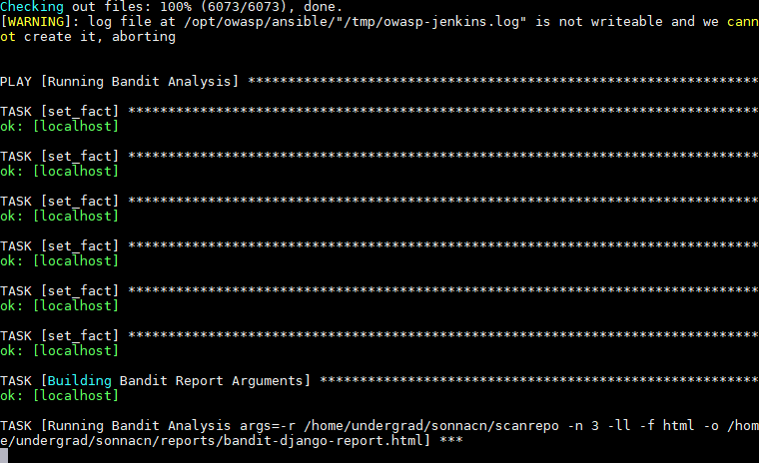
How It Works
Using Docker (https://www.docker.com/) - a program which allows any program to run anywhere with ease
And Ansible, along with Jenkins - deployment automation software
Docker runs the plugin (https://github.com/jay-johnson/owasp-jenkins) which is remotely accessible from any server. This plugin then builds any repositories’ dependencies against the OWASP security toolchain and the NIST National Vulnerability Database.
Then the same utility uses Bandit to scan the plugin itself for vulnerabilities.
Inside the repository there are scripts for running a Jenkins server with the software internally.

Slide 5
Example Output
Output Example
Demo on Terminal

